Slide 1


Space Jumper
By: Urban games
Team members: Alan Chen, George lin, Kong Huang

Slide 2
Overview
The Idea
Why?
Inspiration
Competition
Design
Features
Demo

Slide 3
What? – The Idea
Single player game where an Alien is lost in space and has to find its way back home
Action Packed – multiple obstacles, layouts, and power-ups
Increasing difficulty as the game progresses
Play with one hand
For all ages
Simple and easy with no distracting features

Slide 4
Why?
Team of Gamers – Passion for Games
Entertainment
Productivity
Improving quality of life
Positive emotions
Laughs
Stress Relief
Dopamine rush
Stronger relationships (Co-op)

Slide 5




Inspiration
Space Jumper was inspired by the many of the top games on the app store for its simplicity and addicting features
Crossy Road
Amazing Ninja
Flappy Bird
Stick Hero
2 Cars
Circle
2048
Also Inspired by old gen games
Space Invaders

Slide 6
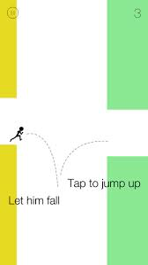
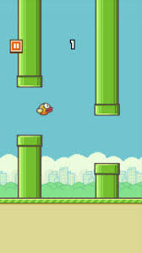
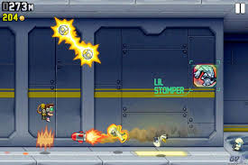
Competition
There are no games currently on the market that combine the scrolling interface, power-ups, multiple obstacles, aliens and space.
However there are similar games
Flappy Bird
Amazing Thief
Jetpack Joyride

Slide 7
Architecture
Sprite Kit
Single View
Originally had three
Compatible across multiple ios devices

Slide 8
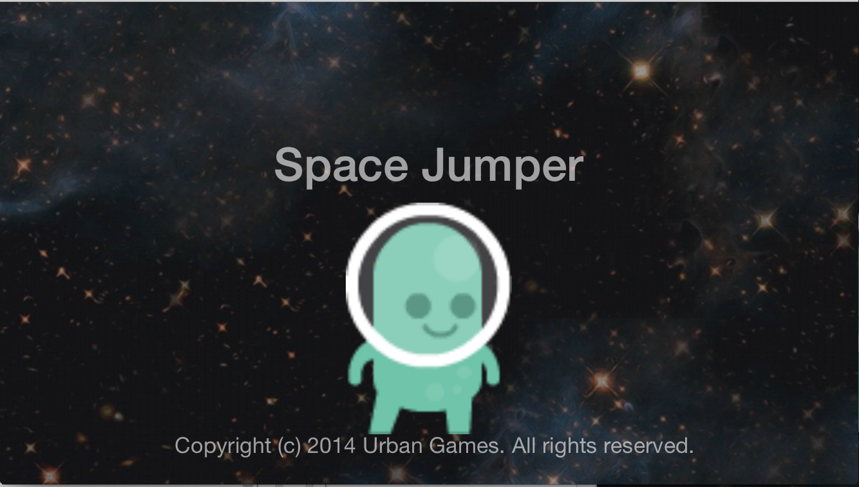
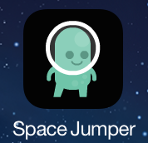
Design – Launch Screen

Slide 9
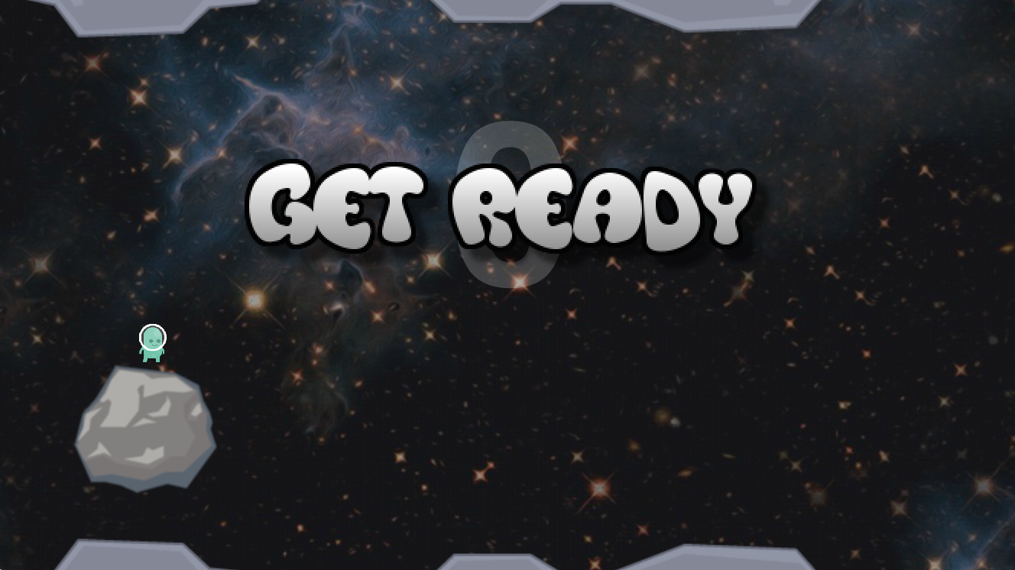
Design – Main Menu

Slide 10
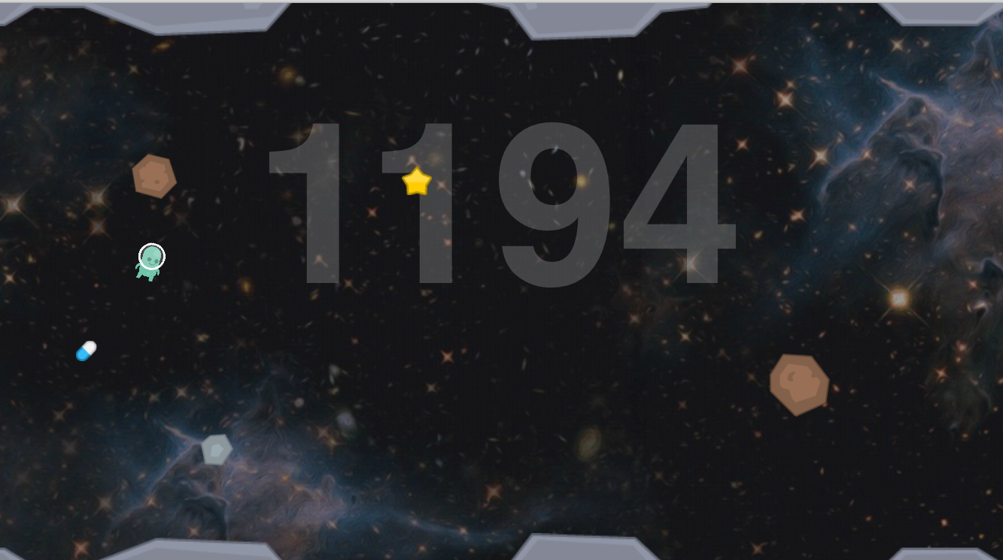
Design – In Game

Slide 11
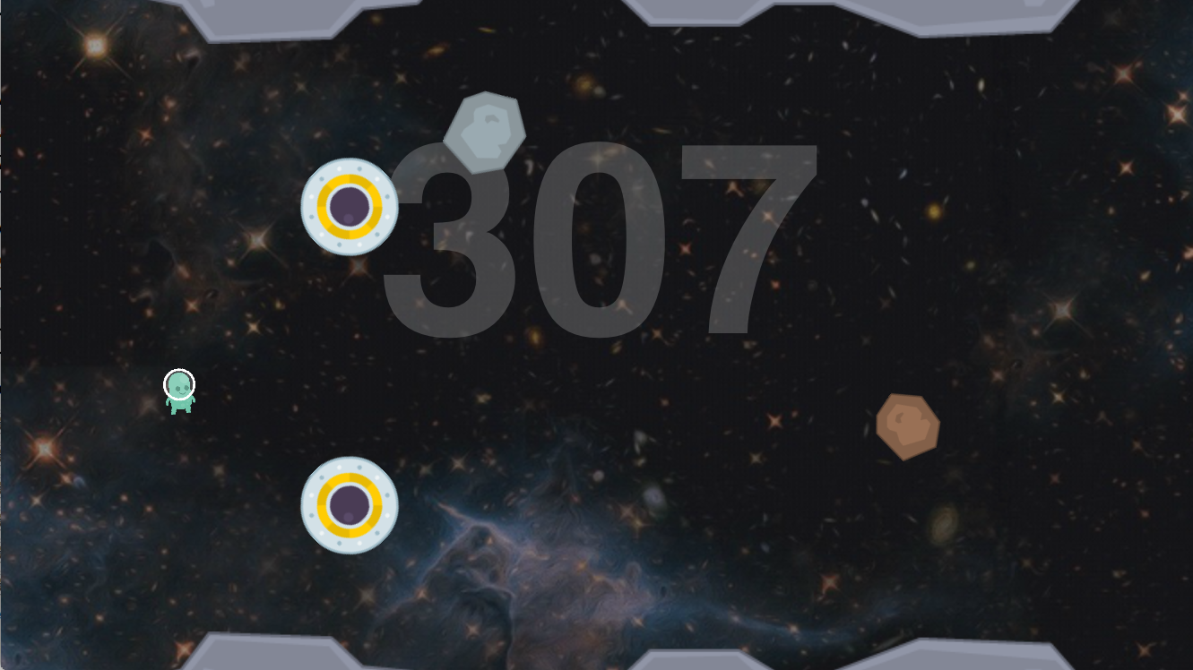
Design – In Game - 2

Slide 12
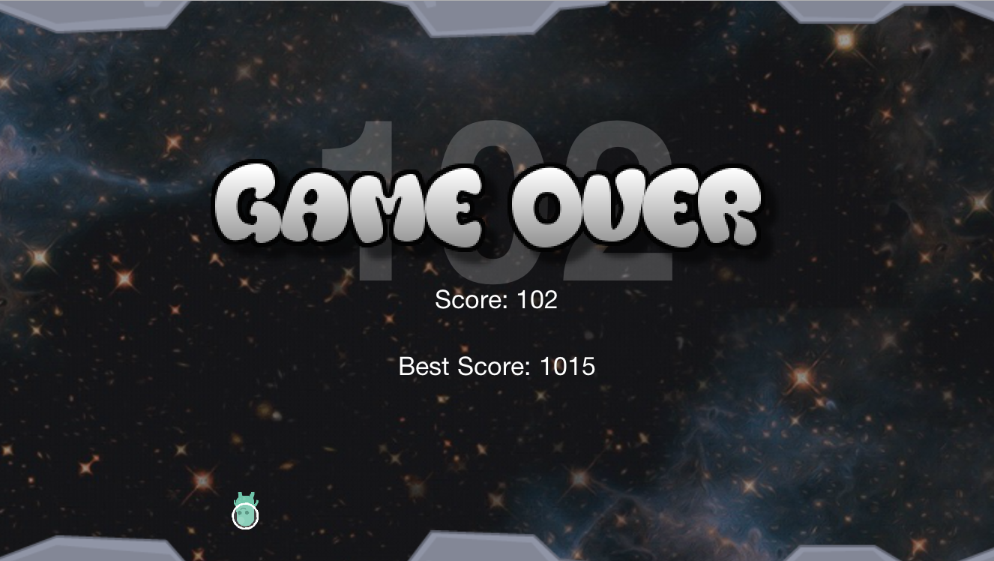
Design – End Game

Slide 13
Features - Game
Score
Best Score
Stores the best score locally to the phone itself
NSUserDefaults.standardUserDefaults()
Current Score
Calculated by the number of meteorites and UFOs avoided
Scores displayed in the background
Music
Background Music
Colliding Music
Jumping Music
Scrolling Background and Terrain
Single Tap
Play Game while holding the handle bar on the subway

Slide 14

Alien
Starting Point is on a rock platform
Platform moves away after the game starts
Mechanics
Affected by a constant negative velocity (“gravity”) to make him fall
Tap applies a vertical impulse (“jump”) to make him jump
Wobble animation
Collision
Square collision
Colliding with meteorites or spaceships ends the game
Colliding with power-ups makes the alien eat them up

Slide 15


Feature - Meteorite
Meteorites
7 types to meteorites
Sizes are randomized
Speed is base on the size
Number of spawned meteorites are based on the time
Location is randomized
Collision is a circle
meteor.physicsBody = SKPhysicsBody(circleOfRadius: meteor.size.width / 2)
Spins
SKAction.rotateByAngle

Slide 16




Feature – UFO’s
Randomized location
Set distance apart
Spins
Multi-Color
Circle Collision

Slide 17
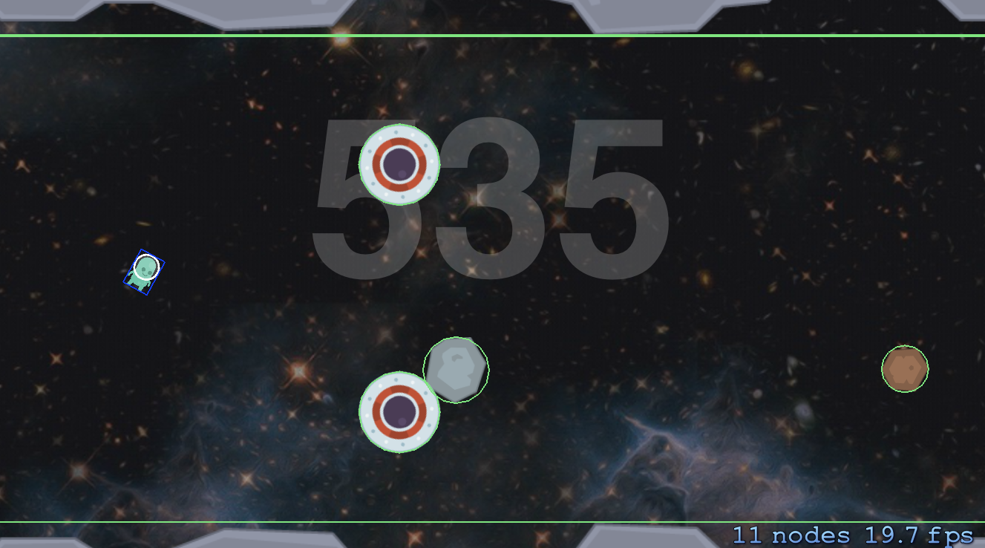
Collision

Slide 18
Power-Ups
Red Pill
Alien become smaller
Blue Pill
Alien becomes bigger
Gold Star
100 Points
Lighting Bolt
New Meteorites becomes smaller
No two Power-ups appear in row
Power-ups have a time limit

Slide 19
Lessons Learned
Making a game is hard
Time
Resources
Art
Sprite Kit is huge!
Collision
SKAction
Update
Multiple ways of doing one thing
View management

Slide 20

The Future
Add buttons
Pause
Restart
Polish UI and animations
Publish to App Store next month
Ads

Slide 21

Demo

Slide 22
Thank You!

